Slide 1
MapReduce: Programming Model and Implementations
Notes:
Greeting
Myself
Today’s topic
Authors
Conference
MapReduce aims to provide a simplified approach to program and run distributed applications
Analogy

Slide 2
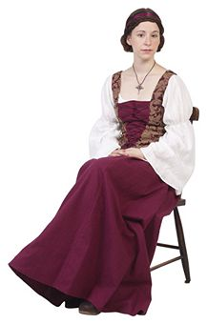
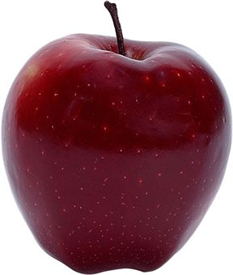

Analogy of Map Reduce Mom told Sam
An apple a day keeps a doctor away!

Slide 3


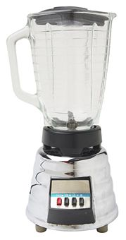


One day
Sam thought of “drinking” the apple
So, he used a to cut the and a to make juice.
Notes:
Compared to eating apple, drinking juice is fun

Slide 4
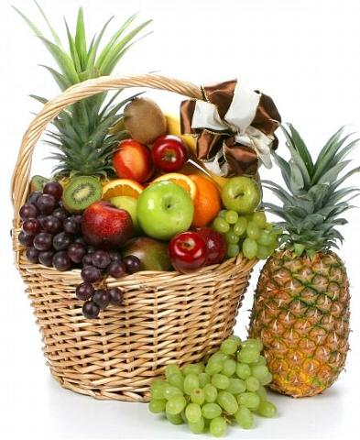
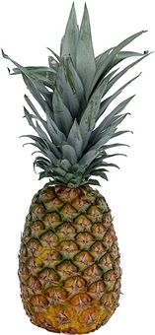
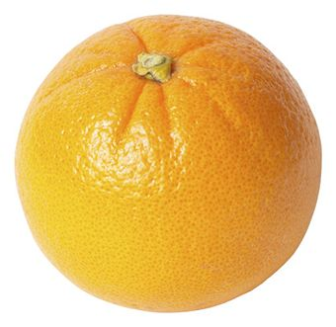

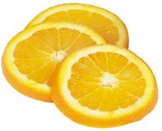
Next Day
Sam applied his invention to all the fruits he could find in the fruit basket
Simple!!!
Notes:
Excited by his success at making apple juice, Sam now wants to make juice from multiple fruits
He excelled at this for sometime and then

Slide 5
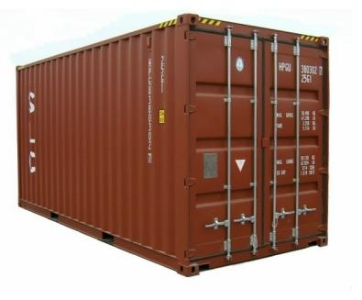
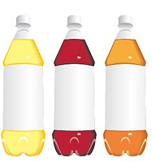
18 Years Later
Sam got his first job with juice making giants, for his talent in making juice
But!
Now, it’s not just one basket but a whole container of fruits
Fruits
Also, he has to make juice of different fruits separately
And, Sam has just ONE and ONE
Notes:
Like with any giant, be it search giants or juice making giants, you are going to have huge numbers at hand
Like search, recommendations, usage analysis, page rank etc?

Slide 6



Sam & MapReduce
Sam implemented a parallel version of his innovation
Fruits

